Slide 1

Microsoft Azure Stack Hub Support
Azure Stack Hub Troubleshooting and Support
This work is licensed under a Creative Commons Attribution - ShareAlike 4.0 International Public License

Slide 2
Agenda
Azure Stack Hub Support Model
Integrated support experience
Lifecycle & Support Policy
What might happen during a support case?
Diagnostics flow
Obtaining Azure Stack Hub Logs
Privileged Endpoint
Troubleshooting common issues

Slide 3
Azure Stack Hub Support Model

Slide 4
Software
Delivering Azure Stack Hub as an Integrated System
Hardware
Support
Azure Stack Hub is an extension of Azure
Services

Slide 5

Azure Stack Hub Support Tenets
What we’re optimizing for…
An Azure-consistent and integrated support experience for Azure Stack Hub
Seamless, with focus on speed and quality of resolution
Customers are not confused about who to call for support
Microsoft and Azure Stack Hub OEM partners can work together with minimal friction

Slide 6
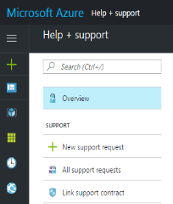


Integrated support experience
Azure-consistent support experience
no matter who you need support from
Coordinated escalation and resolution process
Cloud services support delivered by Microsoft
Existing Azure support or Premier Support contract
System support delivered by hardware partners
System support contract with hardware partners
Microsoft frontline support
Coordinated escalation and resolution process
Customer calls either vendor
Hardware partner frontline support

Slide 7
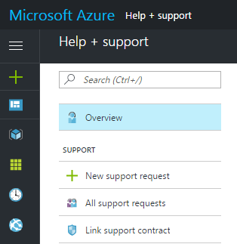





Integrated support experience
Microsoft support case in MSSolve
Microsoft frontline support
Azure Stack Hub SWE team
Analytics Tool
Case exchange
Helen Portal – Control Access
Customer calls either vendor
Partner Support case
Hardware partner frontline support

Slide 8
Scenario-based support boundary
The hardware partner owns (and should be called first for):
All hardware and HW partner-branded SW including HLH related issues.
Ex: If a server or disk or NIC is reported as faulty by the hardware monitoring tool.
Deployment, driver and firmware update, and FRU (field replacement unit) issues.
Ex: If a professional service engineer runs into onsite deployment failures Hardware vendor owns T1/T2 support and escalates to MSFT for T3 support.
Ex: If a customer runs into firmware update issues. Hardware vendor owns resolution.
For everything else, Microsoft or the Cloud Solution Provider should be called first. CSP will own the Tier 1 and 2 support, back-stopped by Microsoft for tier 3 support.

Slide 9
Support offering / Contract breakdown
Who will customers buy support from?
Customer consuming Azure via MSFT
CSP (Service Provider) is the customer
Customer consuming Azure via CSP
Enterprise Customer Support
SP Support
Hardware vendor offering Azure Stack Hub via CSP
1
1
1
HW Partner
HW Partner
HW Partner
EA Customer
Service Provider
Customer
2
2
MSFT
MSFT
MSFT
CSP
Enterprise customer will have two support contracts: 1) HW partners and 2) Microsoft
HW partner covers HW, their own SW and the 3 infra ops scenarios (L1, L2) support. HW partner support will be listed as a line item on the HW BOM
Enterprise customer with Premier or Azure support* will have support coverage for Azure Stack Hub. Support covers Azure services and core fabric sw services.
The service provider customer in this case is a CSP. They will only need to purchase one support contract from HW partners. Their support from MSFT is depending on their CSP support level.
HW partner covers HW and the 3 infra ops scenarios (L1, L2) support. HW partner support will be listed as a line item on the HW BOM
CSP themselves is responsible for L1/L2 support for all Azure services in portfolio including Azure Stack Hub. CSP is backstopped by MSFT for L3 support.
CSP customer will have two support contracts: 1) HW partners and 2) customer’s CSP (which could have been covered when they initially sign up their contract with CSP)
HW partner covers HW and 3 infra ops scenarios (L1, L2) support. HW partner support will be listed as a line item on the HW BOM
CSP is responsible for L1/L2 support for all Azure services in portfolio including Azure Stack Hub. CSP is backstopped by MSFT L3 support.
* Out of 4 levels of Azure support plan, only Developer plan does NOT include Azure Stack Hub.

Slide 10
Azure Stack Hub lifecycle and support policy
Microsoft lifecycle policy
The Microsoft Lifecycle Policy gives you consistent and predictable guidelines for the availability of support throughout the life of a product (https://support.microsoft.com/en-us/lifecycle )
Fixed Lifecycle policies—products with defined end-of-support dates. Ex: Windows 7, Windows Server 2012 etc.
Modern Lifecycle policies—products with continuous service and support. Ex: O365,Dynamics 365 etc.
Customers must stay current as per the servicing & system requirements published for the product or service.
Customers must be licensed to use the product or service
Microsoft must currently offer support for the product or service.
Change Notification : a minimum 30 days' notification for forthcoming modifications.

Slide 11
How to submit a support request (SR)
Enterprise customers go to the Azure portal
http://portal.azure.com and click on Help +Support
Need a valid Azure subscription and Support Plan (Standard, Pro-direct or Premier)
Support can also be initiated directly from Azure Stack Hub Administration portal
Doing this on an ASDK opens the forums
CSP’s use the Microsoft partner portal
https://partner.microsoft.com/en-us/support
Need mpn_id and password.
The process to open a ticket for Azure /Azure Stack Hub support is here
Having Issues?
Contact https://partner.microsoft.com/en-US/support/contact-support

Slide 12
What Might Happen During a Support Case?

Slide 13
Information required during support incidents
When an incident is created, the following information will be required to establish support:
Issue Description Describe the issue in detailed including what triggered the event
Customer Impact statement Provide the impact details for the issue.
Affected components Outline the affected components such as Storage, VMM, or Forwarding Gateway
Logs Provide any error details such as memory dumps, error event logs and screenshots.

Slide 14
What happens if I can’t use the actions?
Example Scenarios: Portal, ARM, Fabric Resource Provider, Directory Service or Storage are offline?
This account is like the server recovery console account in Windows
PS only
JEA
JEA
Service Provider
Machine
Privileged Endpoint
GMSA Domain Admin Account
Infrastructure Role Instances
Microsoft Support
Receives Diagnostic Package
Provides 2nd Phase for Two Way Factor Authentication
Shadows Azure Stack Hub troubleshooting ( Screen Sharing)
Guides Service Provider
Service Provider
1. Create Diagnostic Package
2. Start Unlock Process
3. Receives 2nd Phase Key from Support
4. Drives all input activity

Slide 15
Privileged Endpoint

Slide 16
Privileged Endpoint
Some problems might require a look inside the Azure Stack Hub fabric
There is no direct access to the VMs and/or Hyper-V hosts of the Azure Stack Hub fabric
There is a privileged endpoint (PEP) for emergency operations
Access to this privileged endpoint needs the CloudAdmin account
The PEP can only be elevated in cooperation with Microsoft support

Slide 17
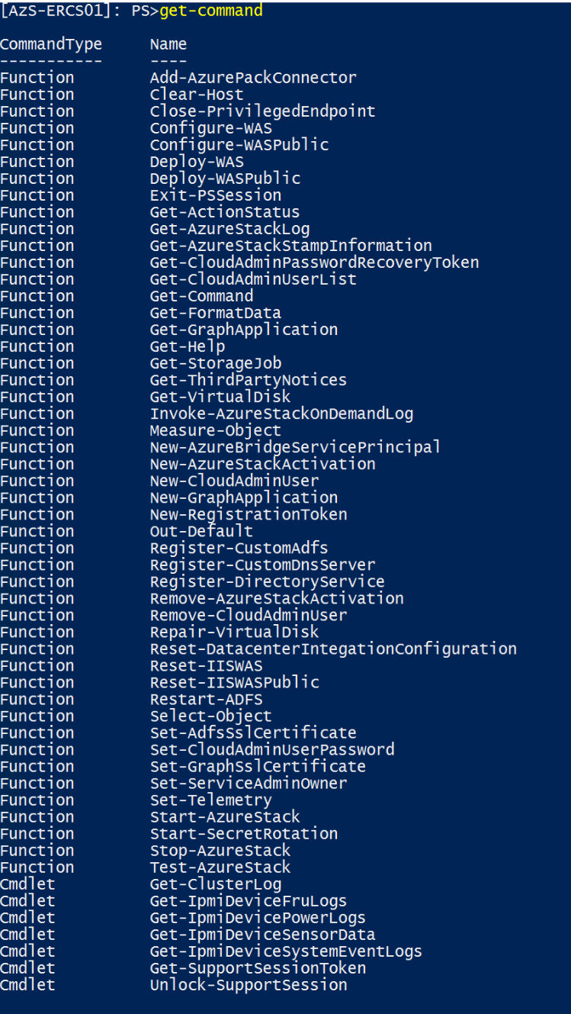
Privileged Endpoint
Preconfigured PowerShell Endpoint
Just enough capabilities to perform basic tasks
Restricted set of commands
Low Privileged account used to access
PowerShell in 'no language mode'
No Scripting is allowed
Can perform various tasks
Collect Diagnostic Logs
Perform Post-integration tasks e.g. AD FS, DNS Forwarders, Certificate rotation
Start, Stop and Test-AzureStack
Work with support to unlock the system

Slide 18
Privileged Endpoint
Access the Endpoint
Initial access through IP address until DNS is setup
Get address from OEM in JSON file “AzureStackStampDeploymentInfo”
Access through a hardened virtual machine running on top of the Hardware Lifecycle Host (HLH) or Privileged Access Workstation (PAW).
Don't use the Hyper-V host of the HLH as jump box
Establish Trust
Cmdlets
Exit PSSession
Enter-PSSession

Slide 19
Privileged Endpoint on HLH or PAW
# ESTABLISH TRUST
# Get ERCS addresses below from AzureStackStampInformation.json
winrm s winrm/config/client '@{TrustedHosts="w.x.y.z, w.x.y.z+1, w.x.y.z+2"}'
# Get Cloud Admin Credentials
$cloudadmincred = Get-Credential
# Create PSSession
$ErcsVmIP = "w.x.y.z, w.x.y.z+1, w.x.y.z+2"
$session = New-PSSession -ComputerName $ErcsVmIP -ConfigurationName PrivilegedEndpoint –Credential $cloudadmincred
# Enter PEP to run cmdlets
Enter-PSSession $session

Slide 20
Import PEP commands on local machine
# ESTABLISH TRUST
# Get ERCS addresses below from AzureStackStampInformation.json
winrm s winrm/config/client '@{TrustedHosts="w.x.y.z, w.x.y.z+1, w.x.y.z+2"}'
# Get Cloud Admin Credentials
$cloudadmincred = Get-Credential
# Create PSSession
$ErcsVmIP = "w.x.y.z, w.x.y.z+1, w.x.y.z+2"
$session = New-PSSession -ComputerName $ErcsVmIP -ConfigurationName PrivilegedEndpoint –Credential $cloudadmincred
# Enter PEP to run cmdlets locally
Import-PSSession $session

Slide 21
Privileged Endpoint
Unlock the System
Elevation of the Privileged Endpoint
If there is no other way to resolve the issue in the portal or through the PEP cmdlets
This exposes the underlying infrastructure by granting network access to all VMs and Hyper-V nodes
Domain Admin level rights are granted for the session
All Actions during the session are logged

Slide 22
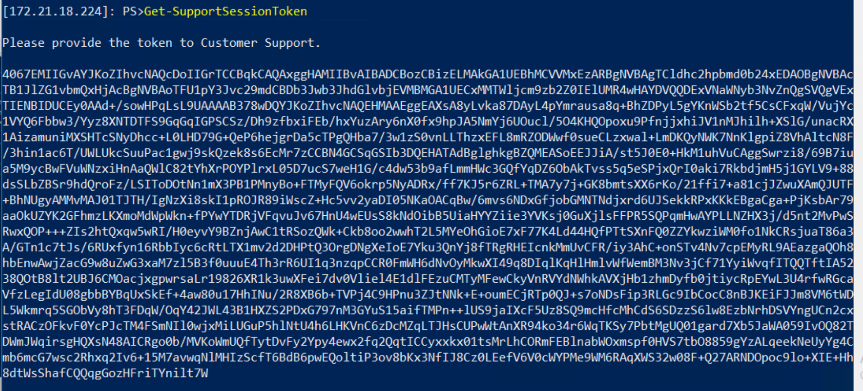
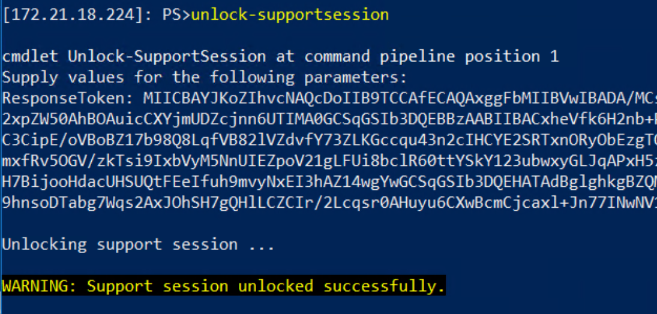
Privileged Endpoint
Unlock the System
Customer retrieves a Support Token for MS Support
Get-SupportSessionToken
MS Support gives a response key back to the customer
Unlock-SupportSession –ResponseToken “Unlock Token”
When done run
Close-PrivilegedEndpoint

Slide 23
Get-AzureStackLog

Slide 24
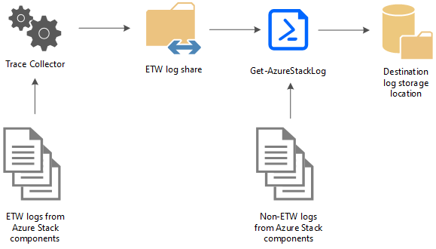
Get-AzureStackLog
Command is used to collect all or specific logs from Azure Stack Hub components
All logs are saved a user-defined UNC Path as zip files
Get-AzureStackLog is available on the (locked) Privileged Endpoint
Get-AzureStackLog –OutputSharePath \\path\of\your\choice -OutputShareCredential $cred

Slide 25
Get-AzureStack additional information
Additional parameters
If the FromDate and ToDate parameters are not specified, logs are collected for the past four hours by default.
The TimeOutInMinutes parameter sets the timeout for log collection. Default is 150 (2.5 hours)
Dump file log collection is disabled by default. To enable it, use the IncludeDumpFile switch parameter.
Get-AzureStackLog_Output.log
A file called Get-AzureStackLog_Output.log is also created in the folder that contains the zipped log files
This file is a log of the command output, which can be used for troubleshooting problems during log collection
Important Information
System and Event logs for the infrastructure VMs are collected in the VirtualMachines role
System and Event logs for the physical hosts are collected in the BareMetal role
Failover Cluster and Hyper-V event logs are collected in the Storage role
ACS logs are collected in the Storage and ACS roles

Slide 26
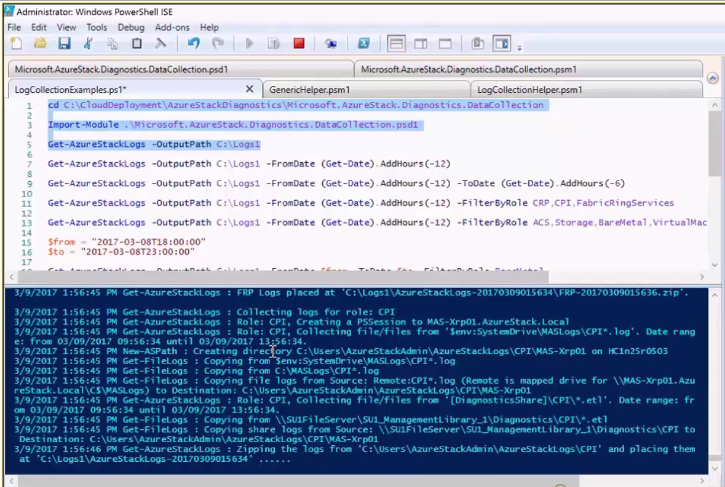
Getting Get-AzureStackLog data
The default grab is all logs for the past 4 hours (default)
This can be adjusted by adding the –FromDate & -ToDate switches
Logs can be filtered by using the –FilterByRole switch

Slide 27
Get-AzureStackLog filtering – How we get the roles we need
Example: Get-AzureStackLog -OutputSharePath "<path>" -OutputShareCredential $cred -FilterByRole VirtualMachines,BareMetal
ACSMigrationService | ACSMonitoringService | ACSSettingsService
ACS | ACSFabric | ACSFrontEnd
ACSTableMaster | ACSTableServer | ACSWac
ADFS | ASAppGateway | BareMetal
BRP | CA | CPI
CRP | DeploymentMachine | DHCP
Domain | ECE | ECESeedRing
FabricRing | FabricRingServices | FRP
Gateway | HealthMonitoring | HRP
IBC | InfraServiceController | KeyVaultAdminResourceProvider
KeyVaultControlPlane | KeyVaultDataPlane | NC
NonPrivilegedAppGateway | NRP | SeedRing
SeedRingServices | SLB | SQL
SRP | Storage | StorageController
URP | UsageBridge | VirtualMachines
WAS | WASPUBLIC | WDS

Slide 28
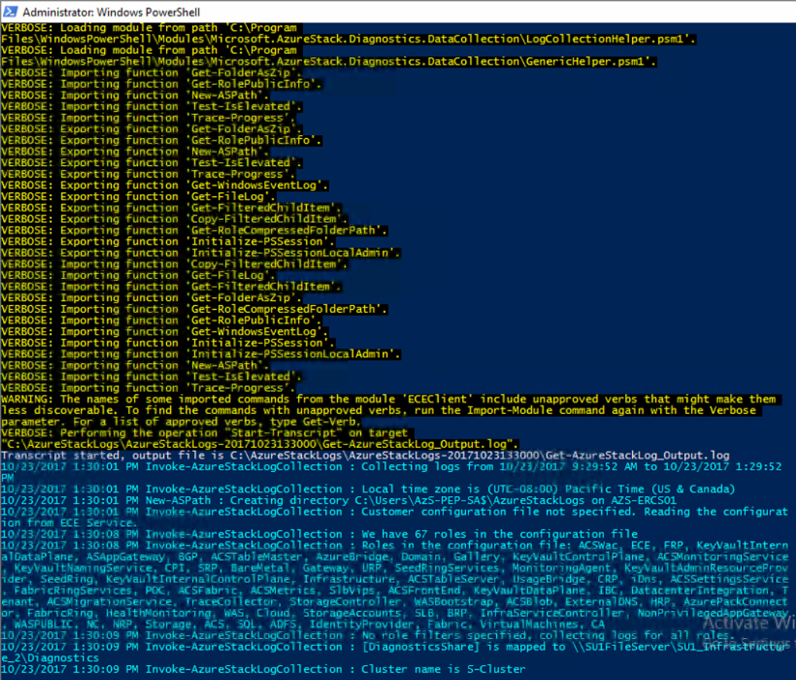
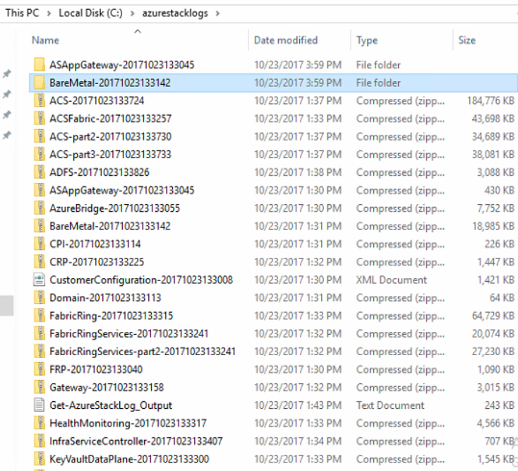
Get-AzureStacklog data collection
The data is collected into the selected location
The data dump is a collection of .Zip file that extracted for analysis

Slide 29




Customer
CSS Engineer
Azure Stack Hub Engineering Team
OEM’s Support Engineer
logs
Helen Portal – Control Access
Azure Storage
Kusto Clusters with log analytics tooling
Log Ingestion Service

Slide 30
Graphical interface tool
Part of aka.ms/AzureStack/Tools
Fully Automated ERCS_AzureStackLogs.ps1 access from http://aka.ms/ERCS
Watch Video on this
THIS IS THE METHOD YOU WANT TO TRY/USE

Slide 31
Troubleshooting
Common Issues

Slide 32
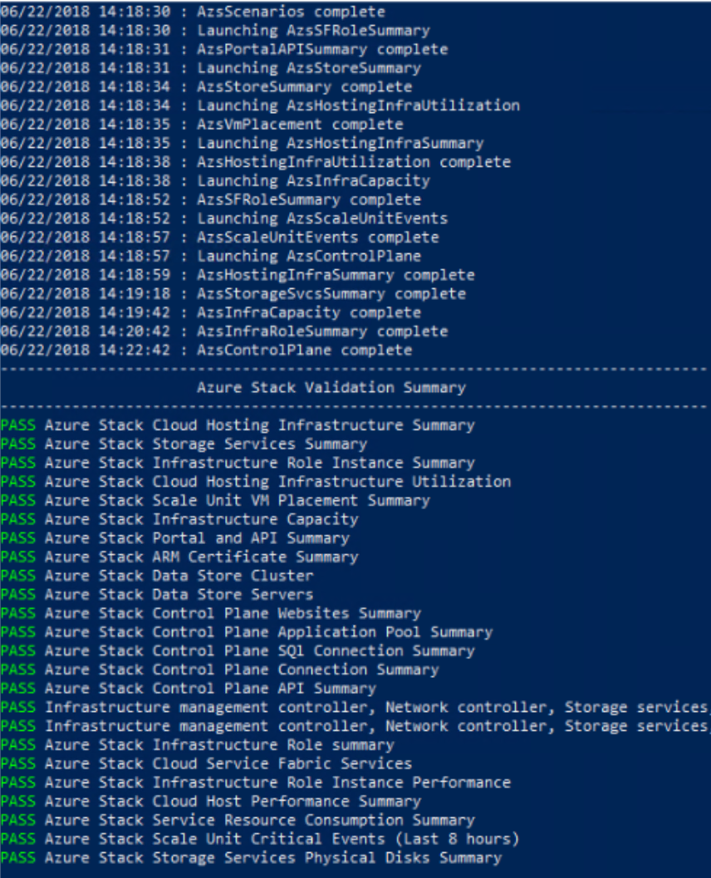
Azure Stack Hub validation
Test-AzureStack
When you have an issue, contact Microsoft Customer Services Support
Support may ask you to run Test-AzureStack from your management node
The validation test can isolate common failures.
Support can then analyze the detailed logs, focus on the area where the error occurred, and work with you in resolving the issue
You should also use Test-AzureStack to check your system readiness before installing updates or hotfixes

Slide 33
What does Test-AzureStack check?
You can use this command to run infrastructure tests or cloud scenario tests against your Azure Stack Hub.
Cloud scenario tests include:
Creating resource groups
Creating plans / Creating offers
Creating storage accounts
Creating a virtual machine
Perform blob operations using the storage account created in the test scenario
Perform queue operations using the storage account created in the test scenario
Perform table operations using the storage account created in the test scenario
Note: Cloud scenarios require cloud administrator credentials

Slide 34
Known issues
Log collection tool takes a long time to run
Check progress in the PS window to make sure tool is running.
You can also track progress in Get-AzureStackLogs_output.log
Date-time and/or role filters can be used to limit the total number of logs collected
Get-AzureStackLog did not collect logs for some roles
This usually happens when there are no logs found that match the date range specified
PowerShell window disappeared while the tool was running
You might have run out of disk space! Check the command output in Get-AzureStackLog_output.log

Slide 35
Other common issues
Resource Providers not registered
When connecting to tenant subscriptions with PowerShell, you will notice that the resource providers are not automatically registered. Use the Connect module, or run the following command from PowerShell (after you install and connect as a tenant):
Get-AzureRMResourceProvider | Register-AzureRmResourceProvider
One current example:
Create Azure Functions before a storage account is ever created
Functions will fail
Fix -> manually enable storage resource provider , then it will work

Slide 36
Questions?

Slide 38
Appendix

Slide 39
Appendix
Using the Azure Stack Hub Privileged EndPoint https://docs.microsoft.com/en-us/azure/azure-stack/azure-stack-privileged-endpoint
Azure Stack Hub Diagnostics https://docs.microsoft.com/en-us/azure/azure-stack/azure-stack-diagnostics
Azure Stack Hub Troubleshooting https://docs.microsoft.com/en-us/azure/azure-stack/azure-stack-troubleshooting
Using the ERSC https://www.youtube.com/watch?v=msoz1wyPj_0
Using the Azure Stack Hub GUI collection tool (ERCS_AzureStackLogs.ps1) https://www.youtube.com/watch?v=Utt7pLsXEBc

Slide 40
Troubleshooting Azure Stack Development Kit -
common issues

Slide 41
Stopping roles in Azure Stack Development Kit
Bellow commands are applicable ONLY to Azure Stack Development Kit
From the Privileged Endpoint
Examples:
Stop-VM -Name "MAS-Con01" -Force -Verbose
Stop-VM -Name "MAS-WAS01" -Force -Verbose
Stop-VM -Name "MAS-Xrp01" -Force -Verbose
Stop-VM -Name "MAS-SUS01" -Force -Verbose
Stop-VM -Name "MAS-ACS01" -Force -Verbose
Stop-VM -Name "MAS-CA01" -Force -Verbose
Stop-VM -Name "MAS-ADFS01" -Force -Verbose
Stop-VM -Name "MAS-ASql01" -Force -Verbose
Stop-VM -Name "MAS-Gwy01" -Force -Verbose
Stop-VM -Name "MAS-SLB01" -Force -Verbose
Stop-VM -Name "MAS-NC01" -Force -Verbose
Stop-VM -Name "MAS-BGPNAT01" -Force –Verbose
The VM MAS-DC01 will shutdown together with the Host

Slide 42
Starting roles back up in Azure Stack Development Kit
Below commands are applicable ONLY to Azure Stack Development Kit
There is a specific boot order that must be followed:
Consider putting a “Start-Sleep -Seconds 60 –Verbose” between each line to give the Azure Stack Hub VM role a chance to boot (see example below)
Start-ClusterResource -Name "Virtual Machine MAS-BGPNAT01" -Verbose
Start-Sleep -Seconds 60 -Verbose
Start-ClusterResource -Name "Virtual Machine MAS-NC01" -Verbose
Start-Sleep -Seconds 60 -Verbose
Start-ClusterResource -Name "Virtual Machine MAS-SLB01" -Verbose
Start-ClusterResource -Name "Virtual Machine MAS-Gwy01" -Verbose
Start-ClusterResource -Name "Virtual Machine MAS-ASql01" -Verbose
Start-ClusterResource -Name "Virtual Machine MAS-ADFS01" -Verbose
Start-ClusterResource -Name "Virtual Machine MAS-CA01" -Verbose
Start-ClusterResource -Name "Virtual Machine MAS-ACS01" -Verbose
Start-ClusterResource -Name "Virtual Machine MAS-SUS01" -Verbose
Start-ClusterResource -Name "Virtual Machine MAS-Xrp01" -Verbose
Start-ClusterResource -Name "Virtual Machine MAS-WAS01" -Verbose
Start-ClusterResource -Name "Virtual Machine MAS-Con01" –Verbose

Slide 43
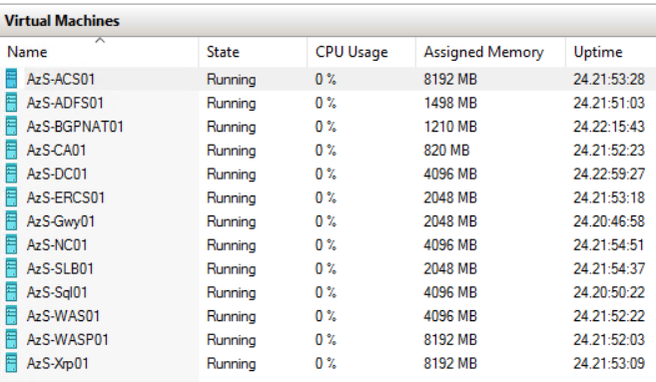
Is the Azure Stack Hub Endpoint running and reachable?
Below procedure is applicable ONLY to Azure Stack Development Kit
These EndPoints (previous slide) are all the Key Roles running as specific portions of the Azure Stack Hub technology suite!
AzS-ERCS01 is the Emergency Recovery Console

Slide 44
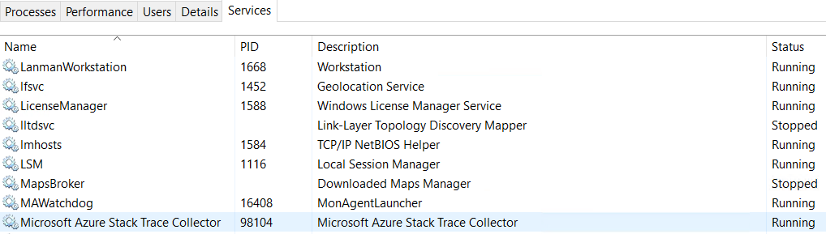
Ensure the trace collector services are running to get data
Below procedure is applicable ONLY to Azure Stack Development Kit
This service runs on the host and the VM’s, but all data is stored on the Azure Stack Hub host

Slide 45
Get-AzureStackLog on the ASDK
Log in as AzureStack\AzureStackAdmin on the host:
Open a PowerShell window as an administrator
Run Get-AzureStackLog -OutputSharePath <PATH> -OutputShareCredential $cred
Examples:
Collect all logs for all roles:
Get-AzureStackLog -OutputSharePath <PATH> -OutputShareCredential $cred
Collect logs from just the VirtualMachines and BareMetal roles:
Get-AzureStackLog -OutputSharePath <PATH> -OutputShareCredential $cred -FilterByRole VirtualMachines,BareMetal
Collect logs from VirtualMachines and BareMetal roles, with date filtering for log files for the past 8 hours:
Get-AzureStackLog -OutputSharePath <PATH> -OutputShareCredential $cred -FilterByRole VirtualMachines,BareMetal -FromDate (Get-Date).AddHours(-8)
Collect logs from VirtualMachines and BareMetal roles, with date filtering for log files for the time period between 8 hours ago and 2 hours ago:
Get-AzureStackLog -OutputSharePath <PATH> -OutputShareCredential $cred -FilterByRole VirtualMachines,BareMetal -FromDate (Get-Date).AddHours(-8) -ToDate (Get-Date).AddHours(-2)

Slide 46
Confirm that Azure Stack Hub roles are up and running
Run the following command from the PEP
Get-ActionStatus Start-AzureStack
Then run Test-AzureStack to verify health of Azure Stack Hub

Slide 47
Current version issues:
After restarting my Azure Stack Hub host, some VMs may not automatically start
After rebooting your host, you may notice Azure Stack Hub services are not immediately available. This is because Azure Stack Hub infrastructure VMs and RPs take a little bit to check consistency, but will eventually start automatically.+
You may also notice that tenant VMs don't automatically start after a reboot of the Azure Stack Development Kit host. This is a known issue, and just requires a few manual steps to bring them online:
To bring Tenant VM’s back online:
On the Azure Stack Development Kit host, start Failover Cluster Manager from the Start Menu
Select the cluster S-Cluster.azurestack.local
Select Roles
Tenant VMs will appear in a saved state. Once all Infrastructure VMs are running, right-click the tenant VMs and select Start to resume the VM

